Slide 1


Computational and Theoretical Study of Disordered Systems
Xiang Cheng
Department of Physics, Emory University
PhD Dissertation Defense
09/23/2016
Supported by the NSF through Grant No. DMR-1207431
Notes:
Thanks for coming.
Generally, better explanations; more to-the-point;

Slide 2
Outline
Introduction of Disordered Systems
Jamming in Hierarchical Networks (HNs)
Antiferromagnetic Ising model in HNs
Aging in Random Field Ising Model
Summary
Notes:
Today, I will first generally introduce disordered systems; then I will explain 3 projects on 3 specific disordered systems; in the end, it is the summary and conclusion.

Slide 3
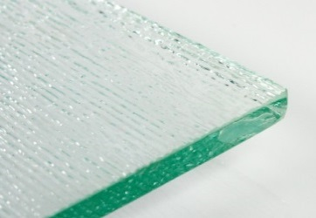

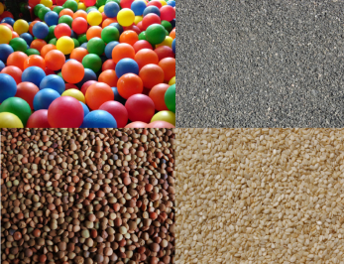
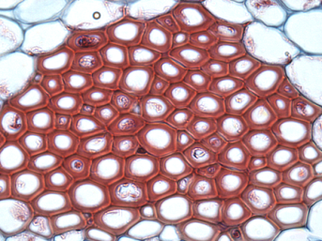
Introduction
Disordered material is the majority
Numerous categories:
Glass, polymer, granular materials, biological tissues, etc.
More unclear questions
Focus on theoretical models
Lattice glass model
Antiferromagnetic Ising model
Random Field Ising model
Notes:
Add pictures;
Most materials in the world may be classified as ordered and disordered materials. For example, crystal is an ordered material, and glass is disordered materials. Usually, there is only one possibility for an ordered material; but disordered material could have infinite possibility. So disorderd material is majority; however it is less studied and there are more questions that are unclear. And these questions

Slide 4
Outline
Introduction of Disordered Systems
Jamming in Hierarchical Networks (HNs)
Antiferromagnetic Ising model in HNs
Aging in Random Field Ising Model
Summary

Slide 5
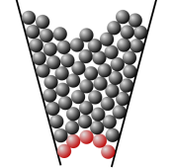

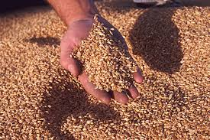

Jamming transition
Jammed states are common.
Characteristics
High packing density (not highest)
Out of equilibrium
Extremely slow relaxation
A challenge to understand
What causes the extremely slow relaxation?
Equilibrium state?
Equilibrium phase transition?
Zhang, .et al and Liu, Nature 459, 230 (2009)

Slide 6
Model: lattice glass model
Biroli-Mezard Model (BM)
Structural disorder → Complex Dynamics
Biroli and Mezard, PRL 88, 2 (2002); Krzakala, Tarzia, and Zdeborova, PRL 101, 165702 (2008)
Notes:
Simple model -> complex and interesting dynamics
Mu -> temperature

Slide 7
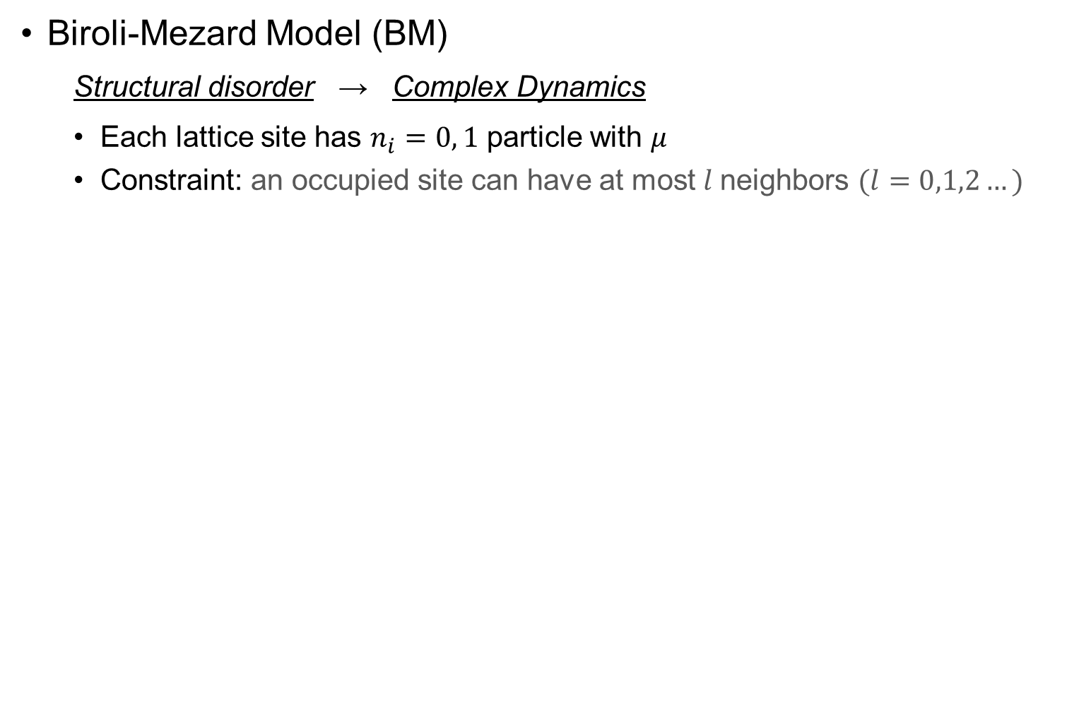
Model: lattice glass model
Biroli-Mezard Model (BM)
Structural disorder → Complex Dynamics
Each lattice site has $n_{i}=0, 1$ particle with $μ$
Constraint: an occupied site can have at most $l$neighbors $(l=0,1,2…)$
Biroli and Mezard, PRL 88, 2 (2002); Krzakala, Tarzia, and Zdeborova, PRL 101, 165702 (2008)
Notes:
Simple model -> complex and interesting dynamics
Mu -> temperature

Slide 8

Model: lattice glass model
Biroli-Mezard Model (BM)
Structural disorder → Complex Dynamics
Each lattice site has $n_{i}=0, 1$ particle with $μ$
Constraint: an occupied site can have at most $l$neighbors $(l=0,1,2…)$
Example: $l=0$
Biroli and Mezard, PRL 88, 2 (2002); Krzakala, Tarzia, and Zdeborova, PRL 101, 165702 (2008)
Notes:
Simple model -> complex and interesting dynamics
Mu -> temperature

Slide 9
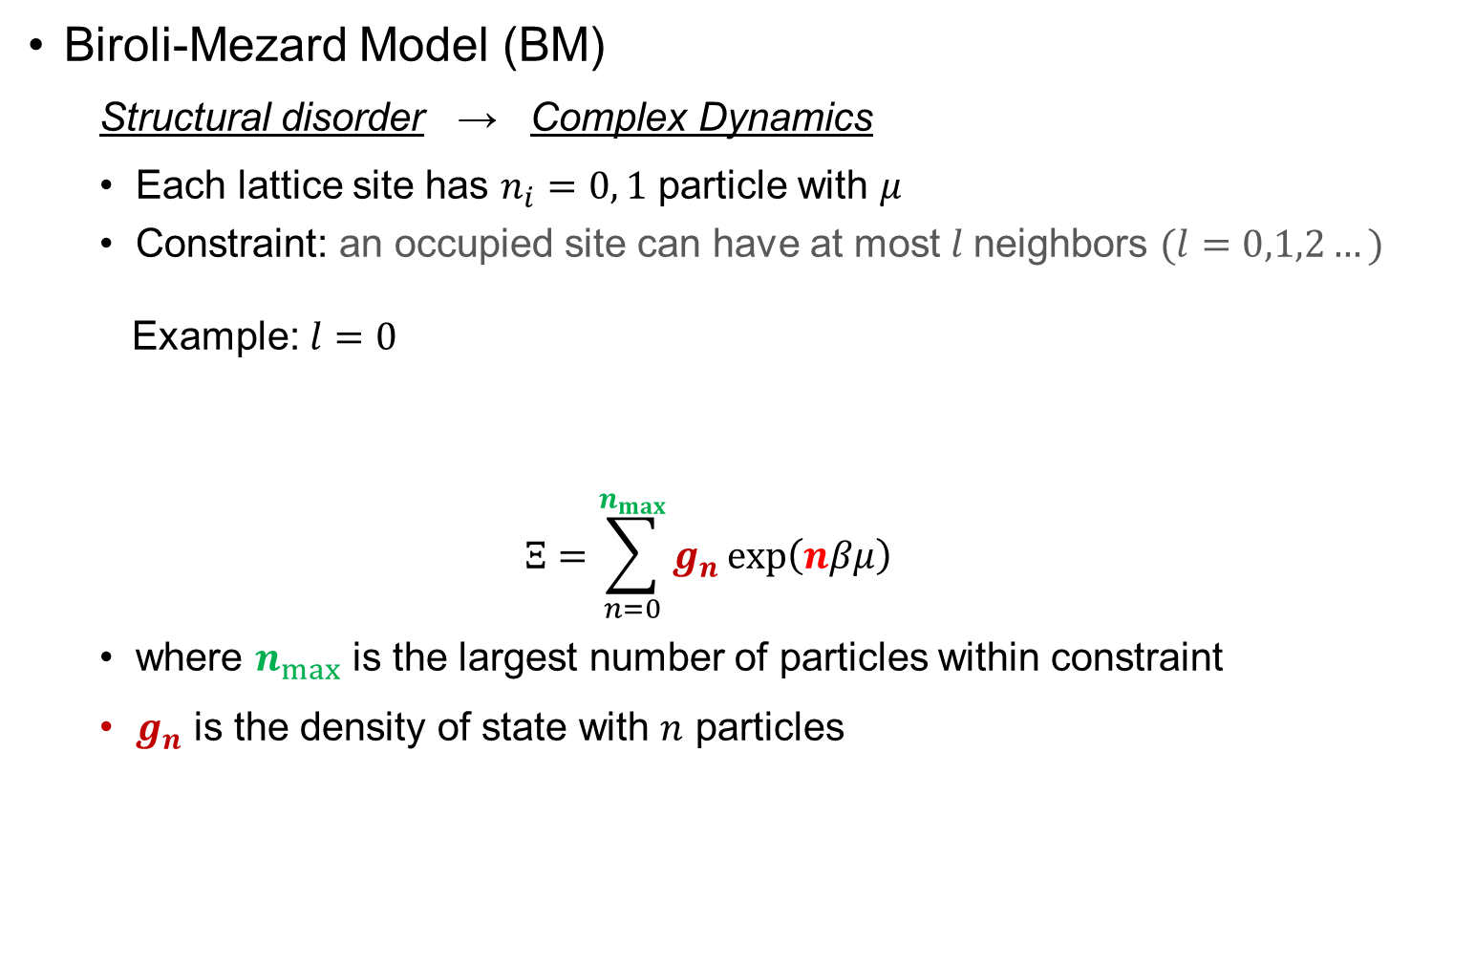
Model: lattice glass model
Biroli-Mezard Model (BM)
Structural disorder → Complex Dynamics
Each lattice site has $n_{i}=0, 1$ particle with $μ$
Constraint: an occupied site can have at most $l$neighbors $(l=0,1,2…)$
Example: $l=0$
$$Ξ=\sum_{n=0}^{n_{max}}{g_{n}\exp\left(nβμ\right)}$$
where $n_{max}$ is the largest number of particles within constraint
$g_{n}$ is the density of state with $n$ particles
Biroli and Mezard, PRL 88, 2 (2002); Krzakala, Tarzia, and Zdeborova, PRL 101, 165702 (2008)
Notes:
Simple model -> complex and interesting dynamics
Mu -> temperature

Slide 10
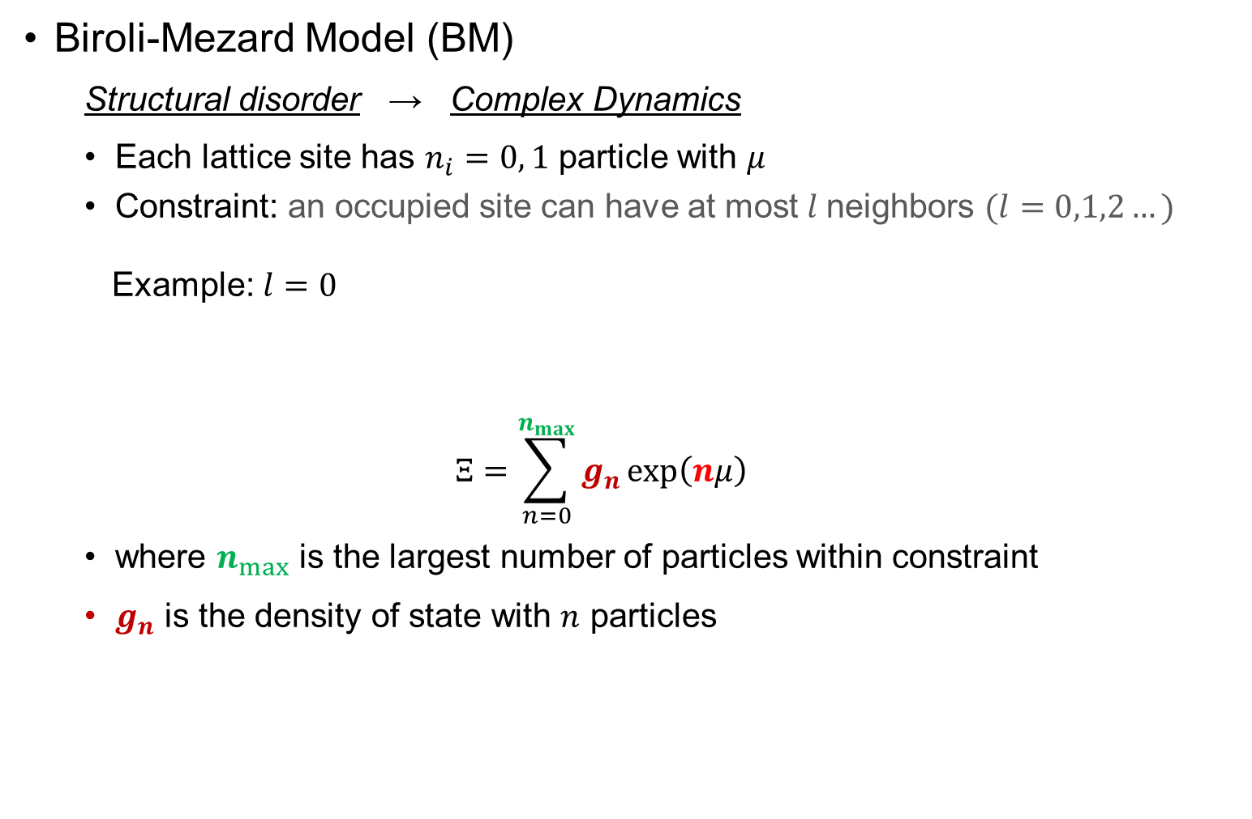
Model: lattice glass model
Biroli-Mezard Model (BM)
Structural disorder → Complex Dynamics
Each lattice site has $n_{i}=0, 1$ particle with $μ$
Constraint: an occupied site can have at most $l$neighbors $(l=0,1,2…)$
Example: $l=0$
$$Ξ=\sum_{n=0}^{n_{max}}{g_{n}\exp\left(nμ\right)}$$
where $n_{max}$ is the largest number of particles within constraint
$g_{n}$ is the density of state with $n$ particles
Biroli and Mezard, PRL 88, 2 (2002); Krzakala, Tarzia, and Zdeborova, PRL 101, 165702 (2008)
Notes:
Simple model -> complex and interesting dynamics
Mu -> temperature

Slide 11
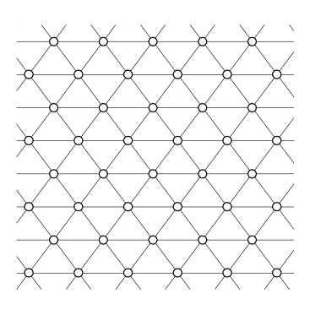
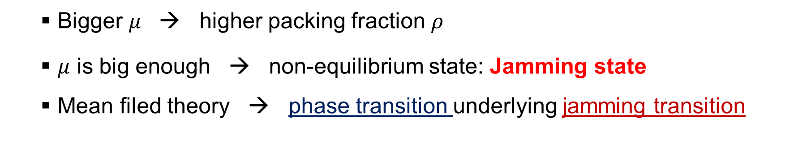
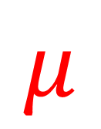
Jamming in lattice glass model
$$μ$$
Bigger $μ$ → higher packing fraction $ρ$
$μ$ is big enough → non-equilibrium state: Jamming state
Mean filed theory → phase transition underlying jamming transition
Biroli and Mezard, PRL 88, 2 (2002); Krzakala, Tarzia, and Zdeborova, PRL 101, 165702 (2008)

Slide 12
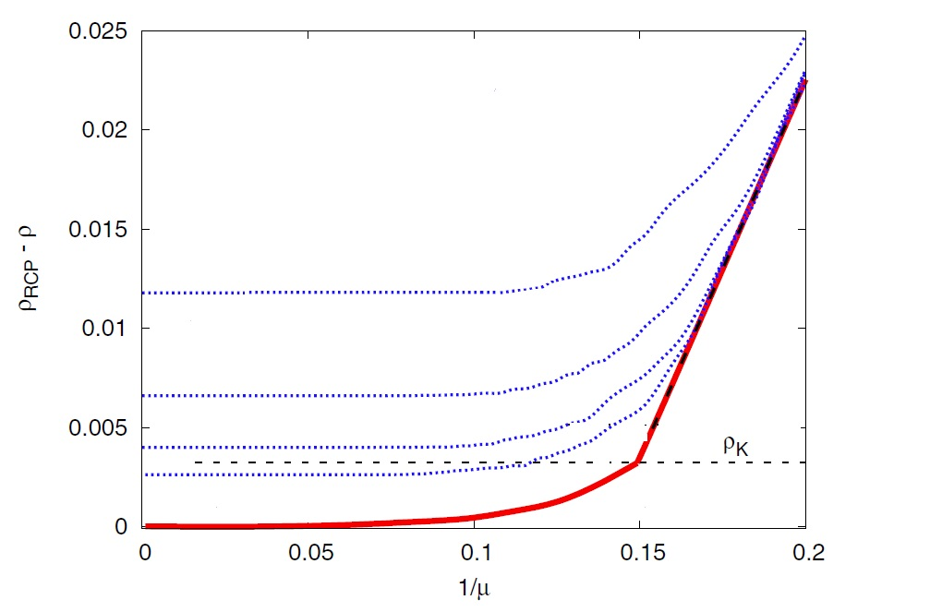
Equilibrium phase transition Jamming Transition?
Mean-field model
Phase transition found underlying jamming transition
True in non-mean-filed model?
Krzakala, Tarzia, and Zdeborova, PRL 101, 165702 (2008)

Slide 13
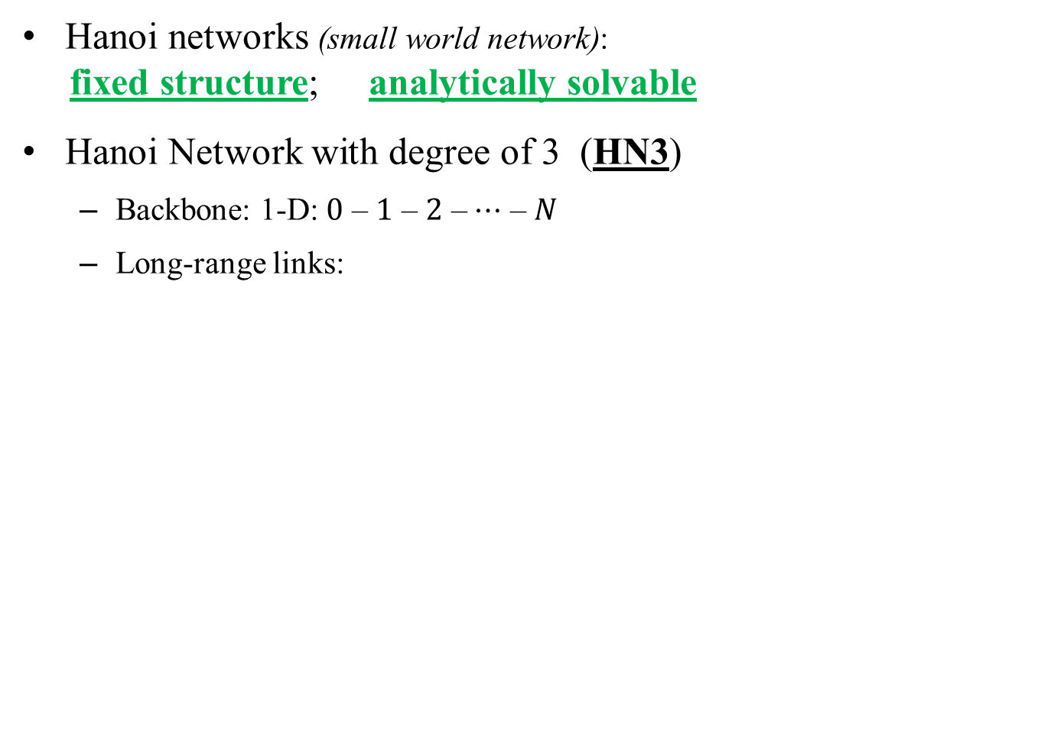
Model: Hierarchical Networks
Hanoi networks (small world network):
fixed structure; analytically solvable
Hanoi Network with degree of 3 (HN3)
Backbone: 1-D: $0$ – $1$ – $2$ – $⋯$ – $N$
Long-range links:
S. Boettcher, B. Goncalves, and H. Guclu, J. Phys. A 41, 252001 (2008)

Slide 14
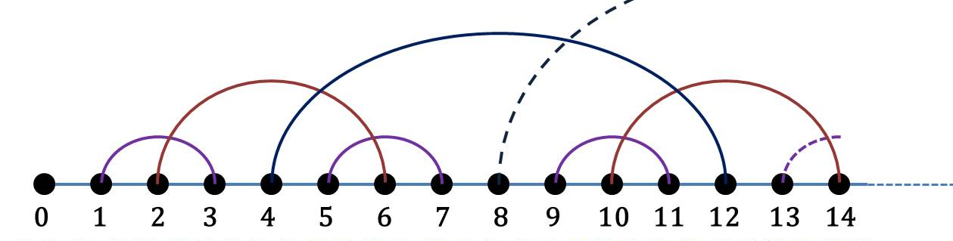
Model: Hierarchical Networks
Hanoi networks (small world network):
fixed structure; analytically solvable
Hanoi Network with degree of 3 (HN3)
Backbone: 1-D: $0$ – $1$ – $2$ – $⋯$ – $N$
Long-range links:
S. Boettcher, B. Goncalves, and H. Guclu, J. Phys. A 41, 252001 (2008)

Slide 15
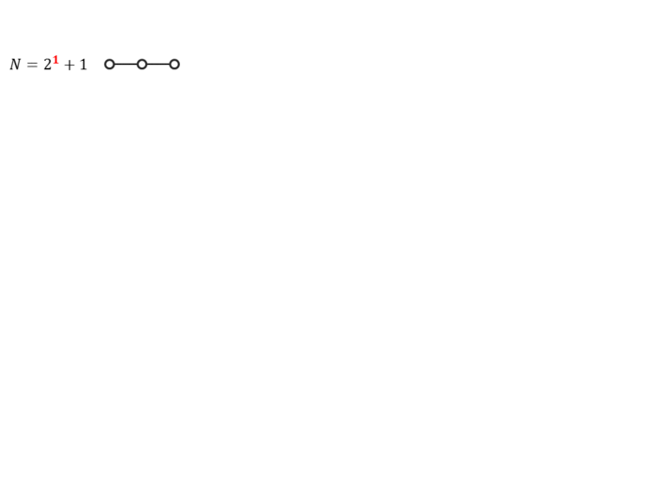
Model: Hierarchical Networks
Hanoi networks (small world network):
fixed structure; analytically solvable
Hanoi Network with degree of 3 (HN3)
Backbone: 1-D: $0$ – $1$ – $2$ – $⋯$ – $N$
Long-range links:
S. Boettcher, B. Goncalves, and H. Guclu, J. Phys. A 41, 252001 (2008)

Slide 16
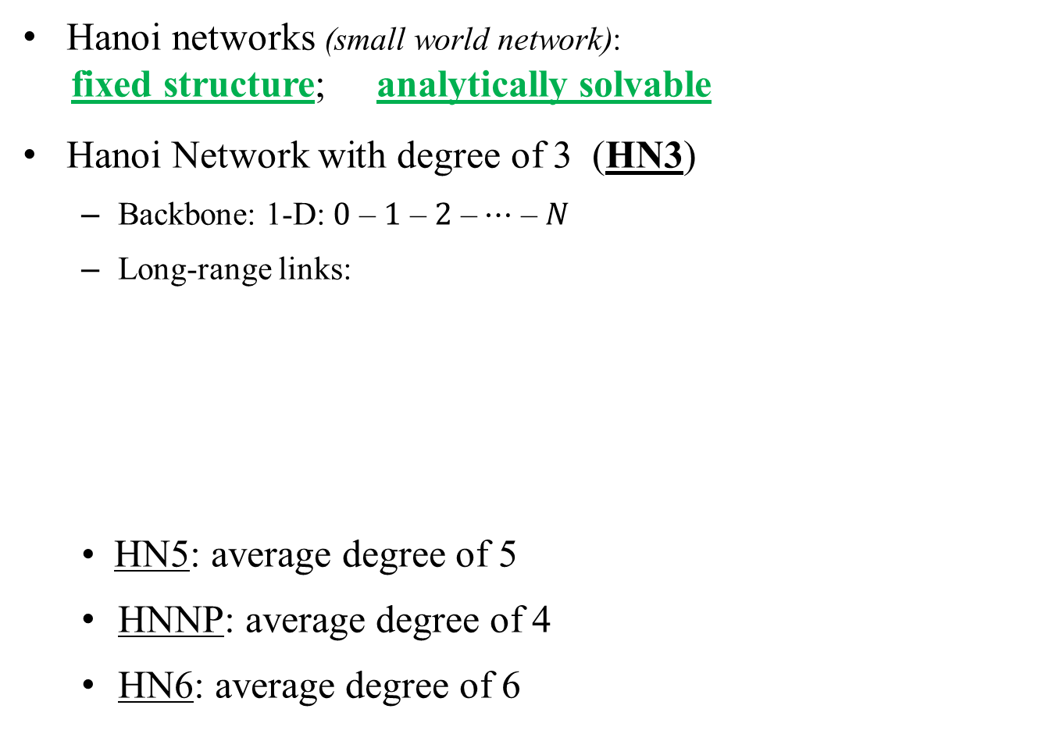
Model: Hierarchical Networks
Hanoi networks (small world network):
fixed structure; analytically solvable
Hanoi Network with degree of 3 (HN3)
Backbone: 1-D: $0$ – $1$ – $2$ – $⋯$ – $N$
Long-range links:
• HN5: average degree of 5
HNNP: average degree of 4
HN6: average degree of 6
S. Boettcher, B. Goncalves, and H. Guclu, J. Phys. A 41, 252001 (2008)

Slide 17
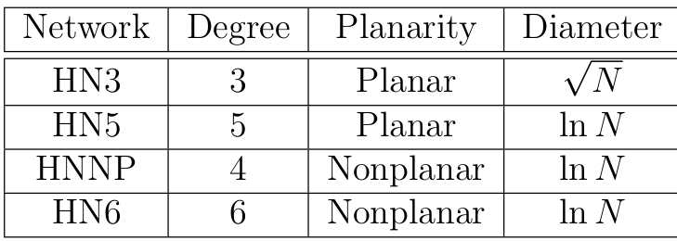
Why Hierarchical Networks (HNs)?
Exactly solvable by Renormalization Group (RG)
Lattice-like structure
Mean-Field HNs Regular lattice
Different structures

Slide 18
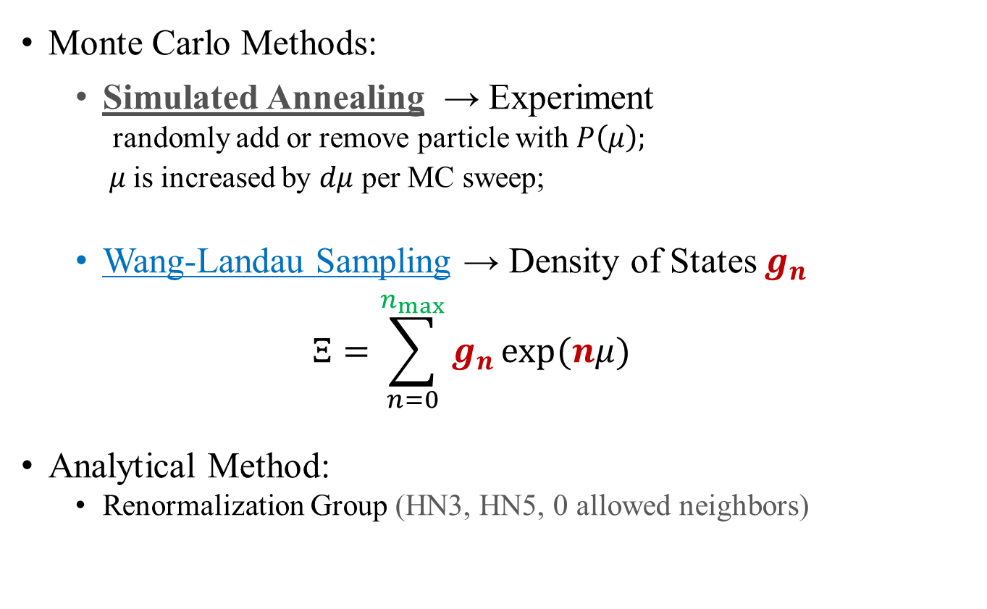
Methods
Monte Carlo Methods:
Simulated Annealing → Experiment
randomly add or remove particle with $P\left(μ\right);$
$μ$is increased by $dμ$ per MC sweep;
Wang-Landau Sampling → Density of States $g_{n}$
$$Ξ=\sum_{n=0}^{n_{max}}{g_{n}}\exp{(nμ)}$$
Analytical Method:
Renormalization Group (HN3, HN5, 0 allowed neighbors)
Notes:
The probability is Boltzmann equation

Slide 19
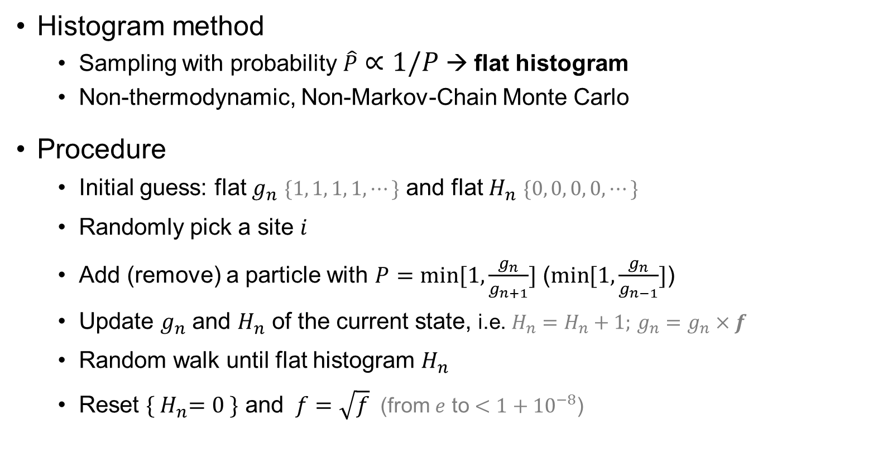
Wang-Landau sampling
Histogram method
Sampling with probability $\hat{P}∝1/P$ → flat histogram
Non-thermodynamic, Non-Markov-Chain Monte Carlo
Procedure
Initial guess: flat $g_{n}$ $\{1, 1, 1, 1,⋯\}$ and flat $H_{n}$ $\{0, 0, 0, 0,⋯\}$
Randomly pick a site $i$
Add (remove) a particle with $P=\min{[1,\frac{g_{n}}{g_{n+1}}]}$ ($\min{[1,\frac{g_{n}}{g_{n−1}}]}$)
Update $g_{n}$ and $H_{n}$ of the current state, i.e. $H_{n}=H_{n}+1;$ $g_{n}=g_{n}×f$
Random walk until flat histogram $H_{n}$
Reset ${\{ H}_{n}=0 \}$ and $f=\sqrt{f}$(from $e$ to $<1+{10}^{−8}$)
Notes:
Extra slides

Slide 20
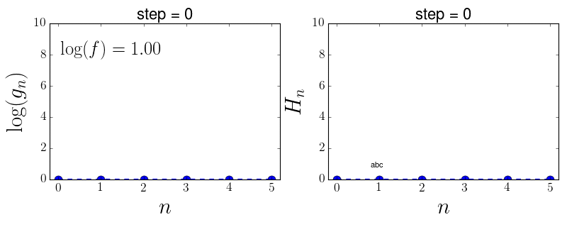
Wang-Landau sampling
Notes:
Extra slides

Slide 21
Wang-Landau sampling
Extremely slow for large system size
Notes:
Extra slides

Slide 22
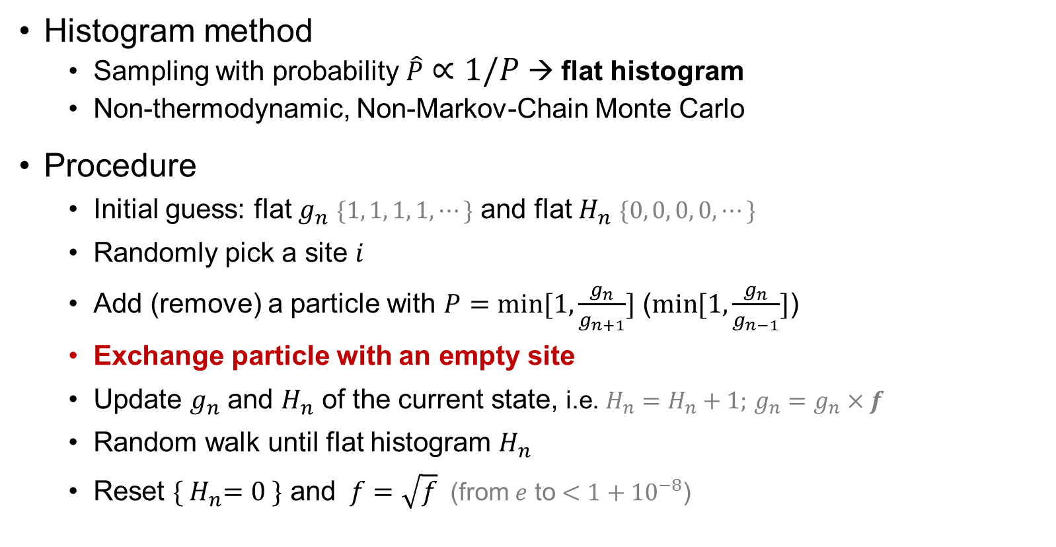
Wang-Landau sampling
Histogram method
Sampling with probability $\hat{P}∝1/P$ → flat histogram
Non-thermodynamic, Non-Markov-Chain Monte Carlo
Procedure
Initial guess: flat $g_{n}$ $\{1, 1, 1, 1,⋯\}$ and flat $H_{n}$ $\{0, 0, 0, 0,⋯\}$
Randomly pick a site $i$
Add (remove) a particle with $P=\min{[1,\frac{g_{n}}{g_{n+1}}]}$ ($\min{[1,\frac{g_{n}}{g_{n−1}}]}$)
Exchange particle with an empty site
Update $g_{n}$ and $H_{n}$ of the current state, i.e. $H_{n}=H_{n}+1;$ $g_{n}=g_{n}×f$
Random walk until flat histogram $H_{n}$
Reset ${\{ H}_{n}=0 \}$ and $f=\sqrt{f}$(from $e$ to $<1+{10}^{−8}$)
Notes:
Extra slides

Slide 23
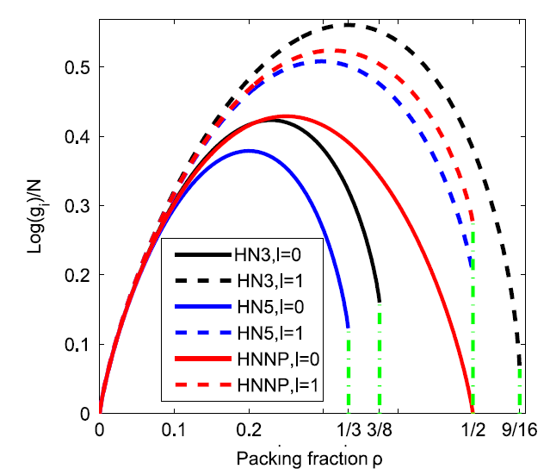
Results of Wang-Landau sampling
N=512
Does NOT converge for larger system size
Notes:
Ground states & Why Wang-Landau fails

Slide 24
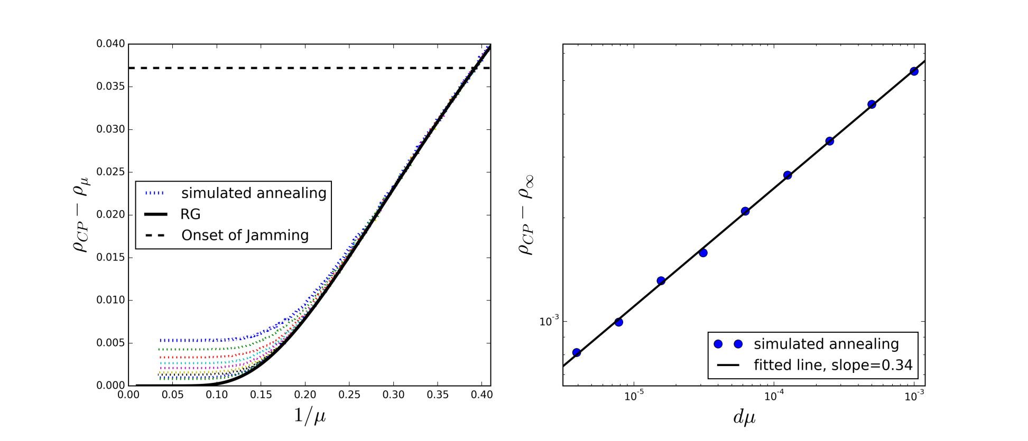

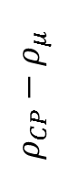
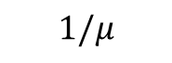
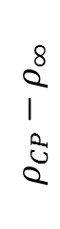
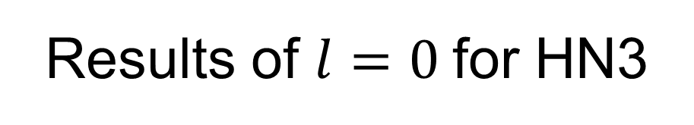
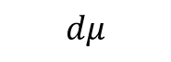
Results of $l=0$for HN3
Simulated annealing vs RG
Power-law relaxation
Jamming transition exists;
No Phase Transition
$$ρ_{CP}−ρ_{μ}$$
$$1/μ$$
$$ρ_{CP}−ρ_{∞}$$
$$dμ$$
Notes:
2 sentences on SA not finding the global maximization;

Slide 25
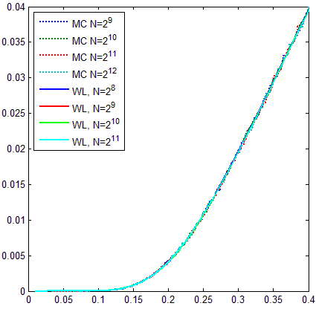
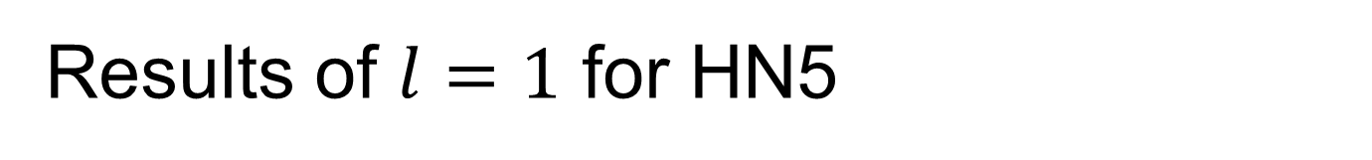
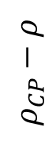
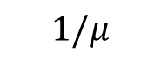
Results of $l=1$ for HN5
Simulation agrees well with Wang-Landau;
Converge faster for large system sizes;
Jamming state DOES NOT exist;
No real phase transition;
$$ρ_{CP}−ρ$$
$$1/μ$$

Slide 26
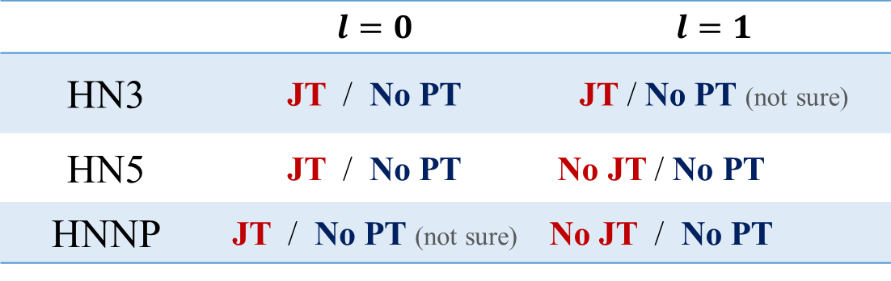
Summary and Conclusion
 | $$l=0$$ | $$l=1$$
HN3 | JT / No PT | JT / No PT (not sure)
HN5 | JT / No PT | No JT / No PT
HNNP | JT / No PT (not sure) | No JT / No PT
JT: Jamming Transition; PT: Phase Transition
Glassy dynamics & power-law relaxation & Jamming transition
Algorithm efficiency improved by more random walk
Notes:
Computational complexity; carefully

Slide 27
Summary and Conclusion
 | $$l=0$$ | $$l=1$$
HN3 | JT / No PT | JT / No PT (not sure)
HN5 | JT / No PT | No JT / No PT
HNNP | JT / No PT (not sure) | No JT / No PT
JT: Jamming Transition; PT: Phase Transition
Glassy dynamics & power-law relaxation & Jamming transition
Algorithm efficiency improved by more random walk
Jamming transition may not necessarily indicate a real phase transition
Notes:
Computational complexity; carefully

Slide 28
Outline
Introduction of Disordered Systems
Jamming in Hierarchical Networks (HNs)
Antiferromagnetic Ising model in HNs
Aging in Random Field Ising Model
Summary

Slide 29
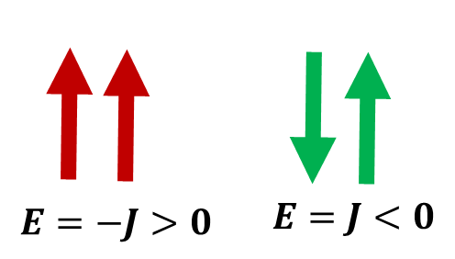
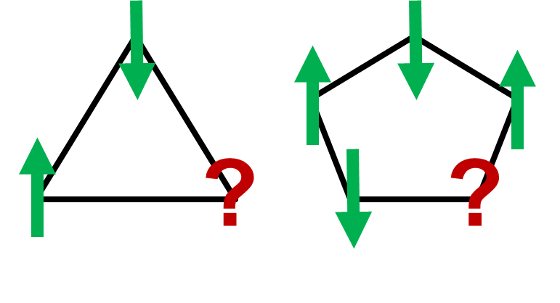
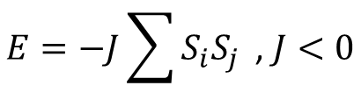
Antiferromagnetic Ising model
Antiferromagnetic Ising model
Geometric frustration: odd loops
$$E=−J\sum{S_{i}S_{j}}\text{ , }J<0$$

Slide 30
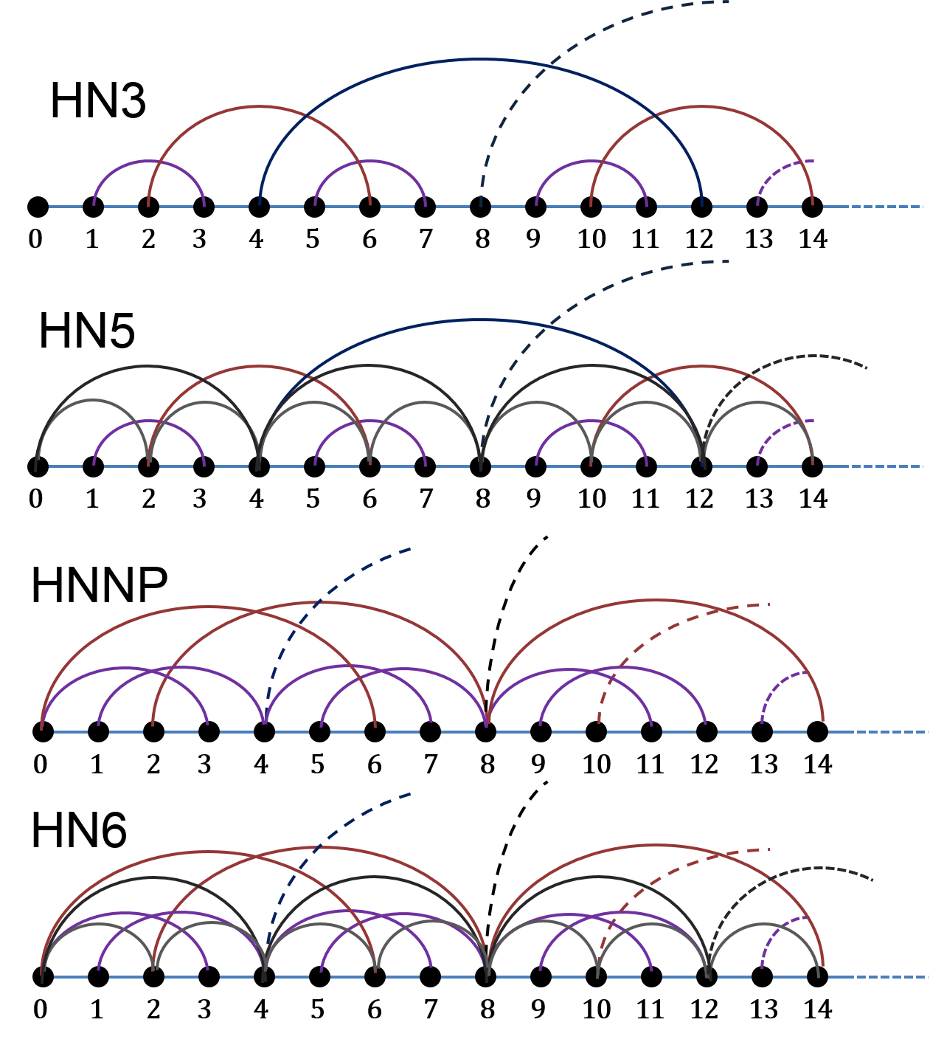
Hierarchical networks (HNs)
HN3
HN5
HNNP
HN6

Slide 31
Hierarchical networks (HNs)
HN3
HN5
HNNP
HN6

Slide 32
Hierarchical networks (HNs)
HN3
HN5
HNNP
HN6

Slide 33
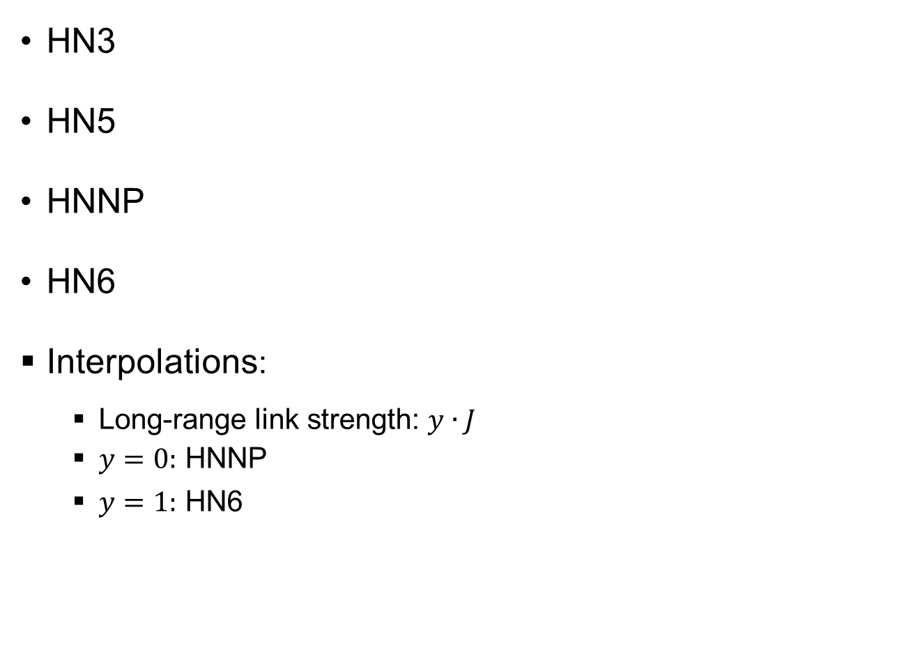
Hierarchical networks (HNs)
HN3
HN5
HNNP
HN6
Interpolations:
Long-range link strength: $y∙J$
$y=0:$ HNNP
$y=1:$ HN6

Slide 34
Research Questions
Anything interesting in this simple model?
Glassy dynamics?
Phase transitions?
Spin glass phase?
Difference to mean-field models?

Slide 35
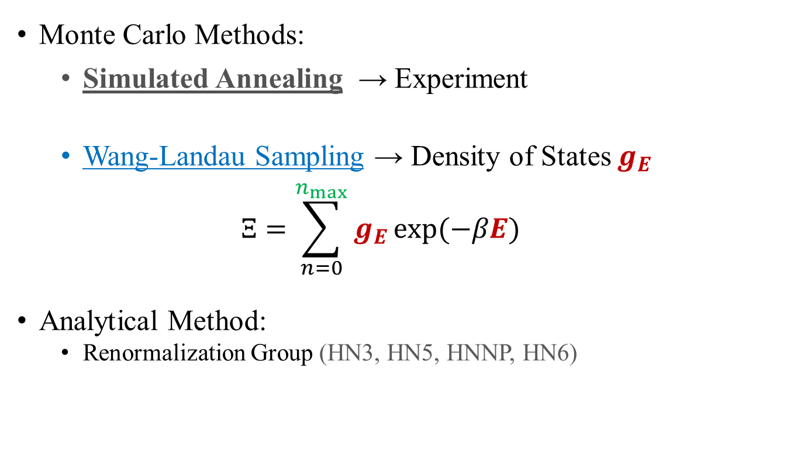
Methods
Monte Carlo Methods:
Simulated Annealing → Experiment
Wang-Landau Sampling → Density of States $g_{E}$
$$Ξ=\sum_{n=0}^{n_{max}}{g_{E}}\exp{(−βE)}$$
Analytical Method:
Renormalization Group (HN3, HN5, HNNP, HN6)

Slide 36
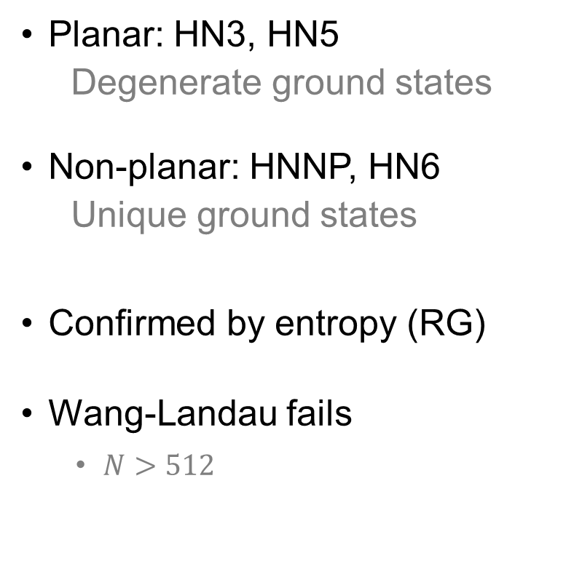
Density of States (WL)
Planar: HN3, HN5
Degenerate ground states
Non-planar: HNNP, HN6
Unique ground states
Confirmed by entropy (RG)
Wang-Landau fails
$N>512$

Slide 37
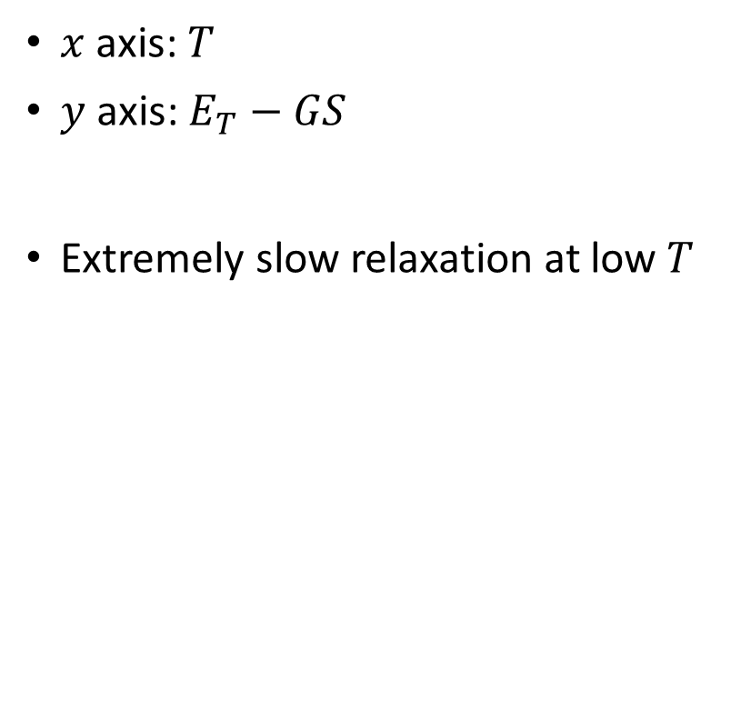
Glassy relaxation (SA)
$x$ axis: $T$
$y$ axis: $E_{T}−GS$
Extremely slow relaxation at low $T$

Slide 38
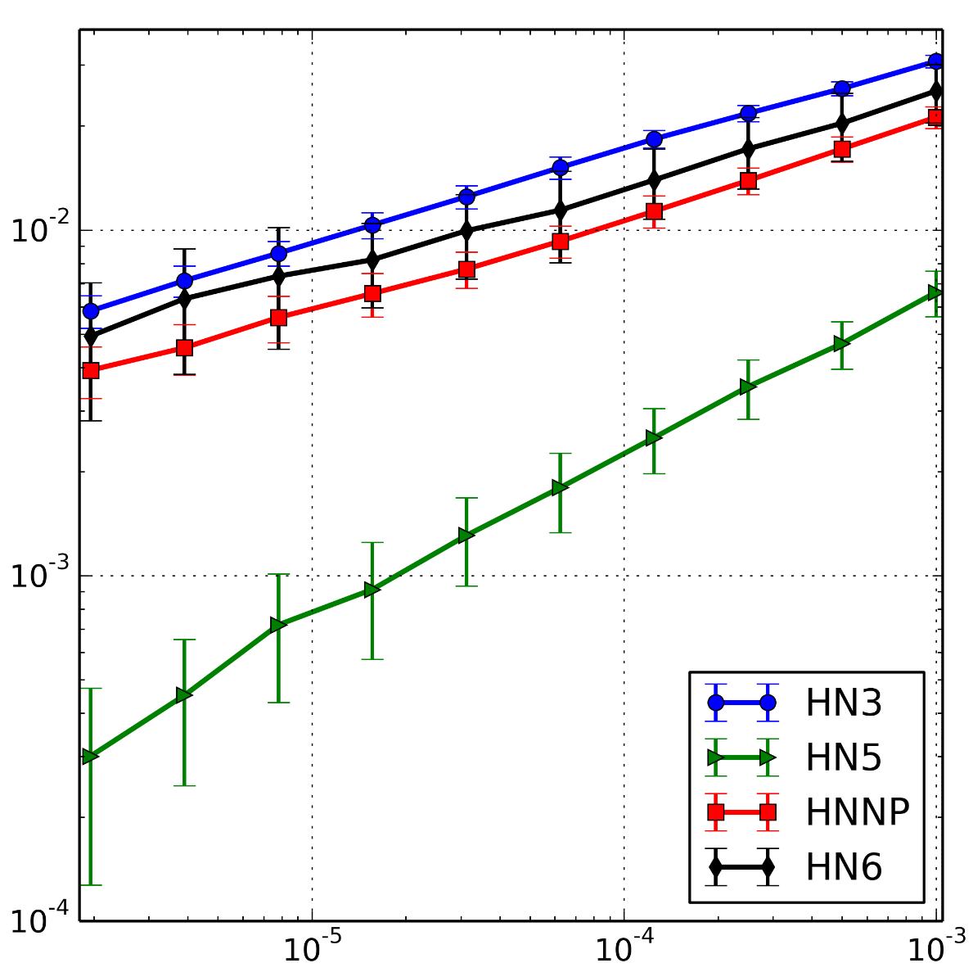
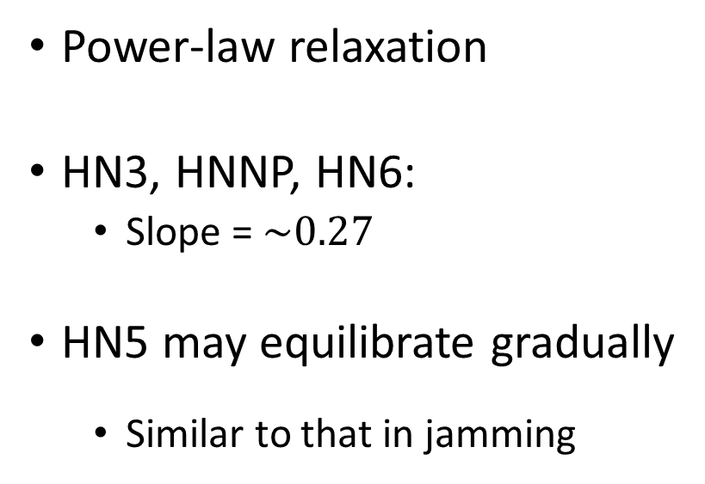
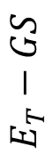
Power-law relaxation (SA)
Power-law relaxation
HN3, HNNP, HN6:
Slope = $\sim 0.27$
HN5 may equilibrate gradually
Similar to that in jamming
$$E_{T}−GS$$
$$dT$$
Notes:
Similar to Jamming case,

Slide 39
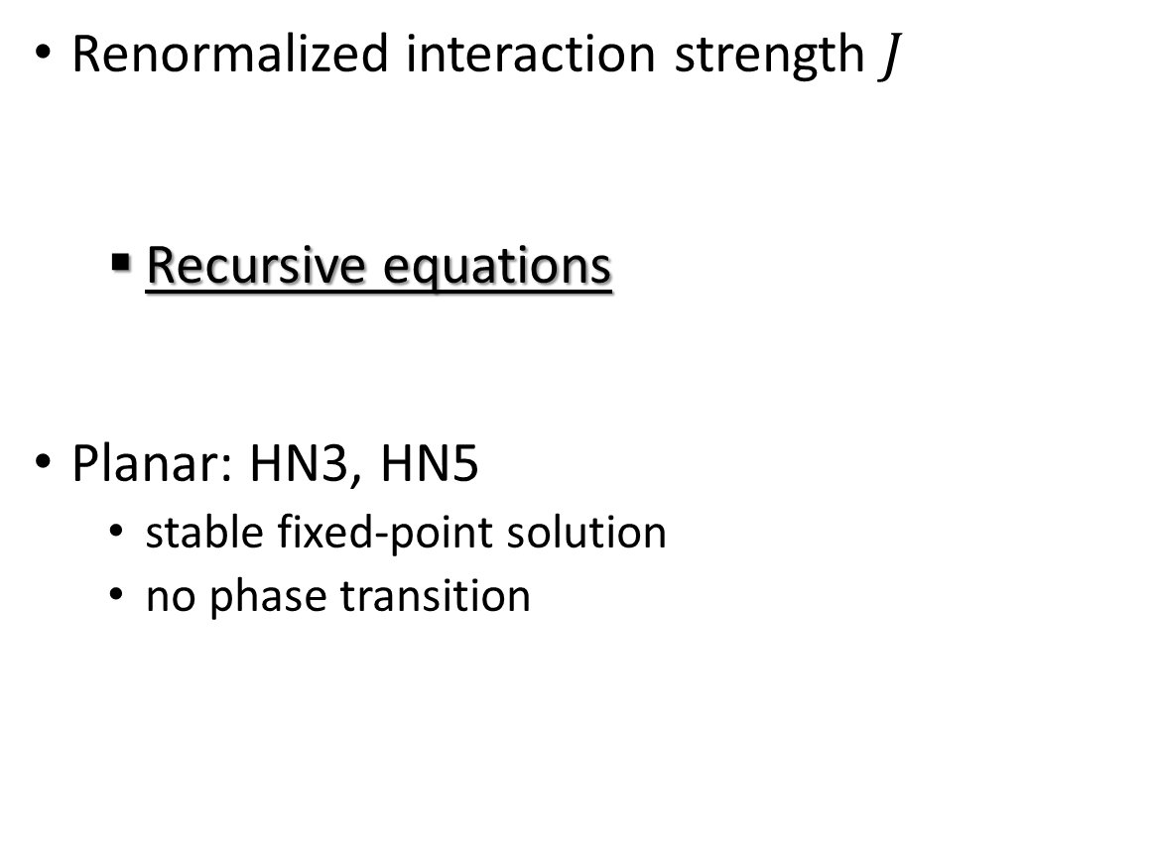
Spin glass transition (RG)
Renormalized interaction strength $J$
Recursive equations
Planar: HN3, HN5
stable fixed-point solution
no phase transition
Numerical solution
Analytical solution
McKay and Berker, Phys. Rev. Lett. 48, 11 (1982)

Slide 40
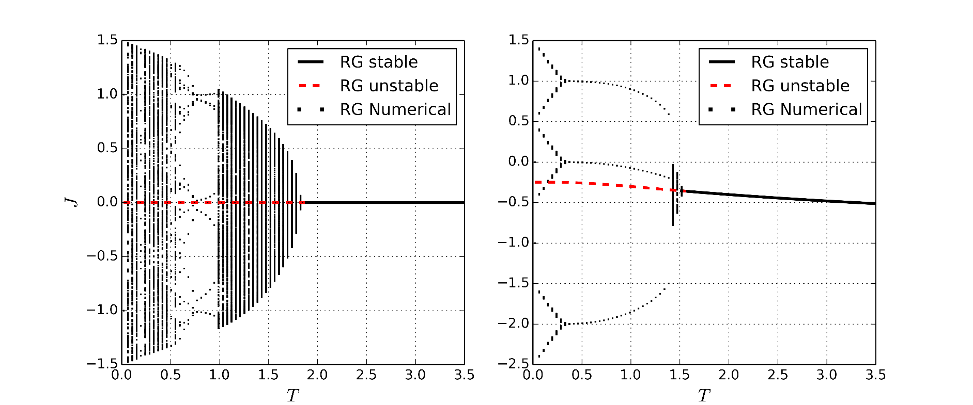

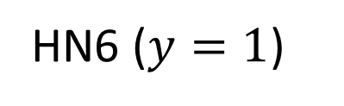
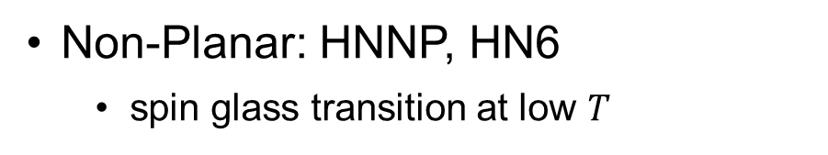
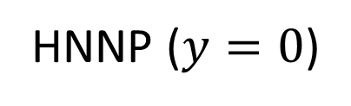
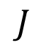



Spin glass transition (RG)
Non-Planar: HNNP, HN6
spin glass transition at low $T$
HNNP ($y=0$)
HN6 ($y=1$)
$$J$$
$$J$$
$$T$$
$$T$$
McKay and Berker, Phys. Rev. Lett. 48, 11 (1982)

Slide 41


Free energy chaos
Boundary conditions
Parallel: up-up
Anti-parallel: up-down
Crossings $N_{C}$

Slide 42

Free energy chaos
Boundary conditions
Parallel: up-up
Anti-parallel: up-down
Crossings $N_{C}$
Power-law scaling

Slide 43

Phase Diagram
Paramagnetic phase
Ferromagnetic
Spin Glass
$$y$$

Slide 44
Summary and Conclusion
Glassy dynamics and power-law relaxation
Free energy chaos in non-planar networks
Spin glass phase transition
Simple model → rich findings
Paramagnetic phase
Ferromagnetic
Spin Glass

Slide 45
Outline
Introduction of Disordered Systems
Jamming in Hierarchical Networks (HNs)
Antiferromagnetic Ising model in HNs
Aging in Random Field Ising Model
Summary

Slide 46

Motivation
Quenched disorder at F-AF interface
Arrhenius activation of magnetic domains*
H_{ex}
H_{ex}
$$τ=τ_{0}\exp\left(\frac{E}{k_{B}T}\right)$$
In the experiment:
Power-law relaxation; small exponent
* E. Fulcomer, S.H. Charap, JAP 1972, and many more thereafter

Slide 47


Random Field Ising Model
Proposed by Imry and Ma in 1975
Studied experimental systems:
diluted antiferromagnets, impure substrates, magnetic alloys
simulate aging in thin-film F/AF bilayers
$J=1$: coupling constant
$h_{i}$ : quenched random field
$$H=−J\sum_{<ij>}{ s_{i}s_{j}}+\sum_{i}{{h_{i}s}_{i}}$$
Imry and Ma, PRL, 35-21 (1975).

Slide 48
Monte Carlo Simulation
Experiment
1. Thin film
2. Cool down slowly
3. Measure resistance
4. Flip external field
Simulation
1. 2D square lattice
2. Simulated annealing
3. Measure energy
4. Flip random fields
1. Initial State
2. After Annealing

Slide 49
Monte Carlo Simulation
Experiment
1. Thin film
2. Cool down slowly
3. Measure resistance
4. Flip external field
Simulation
1. 2D square lattice
2. Simulated annealing
3. Measure energy
4. Flip random fields
1. Initial State
2. After Annealing

Slide 50
Monte Carlo Simulation
Experiment
1. Thin film
2. Cool down slowly
3. Measure resistance
4. Flip external field
Simulation
1. 2D square lattice
2. Simulated annealing
3. Measure energy
4. Flip random fields
1. Initial State
2. After Annealing

Slide 51
Monte Carlo Simulation
Experiment
1. Thin film
2. Cool down slowly
3. Measure resistance
4. Flip external field
Simulation
1. 2D square lattice
2. Simulated annealing
3. Measure energy
4. Flip random fields
1. Initial State
2. After Annealing

Slide 52
Monte Carlo Simulation
Experiment
1. Thin film
2. Cool down slowly
3. Measure resistance
4. Flip external field
Simulation
1. 2D square lattice
2. Simulated annealing
3. Measure energy
4. Flip random fields
1. Initial State
2. After Annealing

Slide 53
Monte Carlo Simulation

Slide 54

Monte Carlo Simulation
$$\left\langle e\right\rangle =e_{0}+A∙t^{−c}$$

Slide 55
Power-law relaxation

Slide 56
Summary and Conclusion
Simulations agree well with experiments
Power-law relaxation is confirmed
Help understand aging in magnetic systems

Slide 57


Summary and Conclusion
3 Disordered Systems
Lattice glass model: dynamics- & geometry-induced disorder
Antiferromagnetic Ising model: geometry-induced disorder
Random field Ising model: quenched disorder
Glassy dynamics & power-law relaxation
Equilibrium phase transition is not necessary
Glassy dynamics & chaos indicate computational complexity

Slide 58
Acknowledgement

Slide 59


Motivation
Quenched disorder at F-AF interface
Imry-Ma-type domains
H_{ex}
H_{ex}
=
=
Arrhenius activation of magnetic domains*
H_{ex}
H_{ex}
$$τ=τ_{0}\exp\left(\frac{E}{k_{B}T}\right)$$
In the experiment:
Power-law relxation; small exponent
* E. Fulcomer, S.H. Charap, JAP 1972, and many more thereafter

